Slide 1


ICRF 17 ^{TH} ANNUAL LUNCHEON
SUNDAY, NOVEMBER 13, 2022

Slide 2


THE ISRAEL CANCER RESEARCH FUND IS PROUD TO PRESENT
FONDS ISRAÉLIEN DE RECHERCHE SUR LE CANCER SONT FIER DE VOUS PRÉSENTER
H A Y L E Y A R C E N E A U X
HONOURING
| EN L’HONNEUR DE
A N Z I E S T E I N
C A T H E R I N E M E L L I N G T U R N E R
D R . S A R A S O L D E R A
!

Slide 3

WITH SINCERE APPRECIATION THE ISRAEL CANCER RESEARCH FUND GRATEFULLY ACKNOWLEDGES THE KIND AND GENEROUS SUPPORT IT HAS RECEIVED FROM ALL OF ITS
C’EST AVEC UNE PROFONDE GRATITUDE
QUE LA FONDS ISRAÉLIEN DE RECHERCHE SUR LE CANCER REMERCIE SINCÈREMENT TOUS SES COMMANDITAIRES, SES
ANNONCEURS ET SES AMIS POUR LEUR BIENVEILLANTE GÉNÉROSITÉ QUI
A PERMIS LE SUCCÈS DE NOTRE JOURNÉE-BÉNÉFICE.
SPONSORS, ADVERTISERS AND
FRIENDS WHO HAVE HELPED MAKE OUR BENEFIT A SUCCESS.
Thank you
SUNDAY, NOVEMBER 13 ^{TH} 2022 LE WINDSOR BALLROOM
Merci
DIMANCHE LE 13 NOVEMBRE 2022 LE SALON WINDSOR

Slide 4


T H A N K Y O U T O O U R
D I A M O N D
S P O N S O R

Slide 5
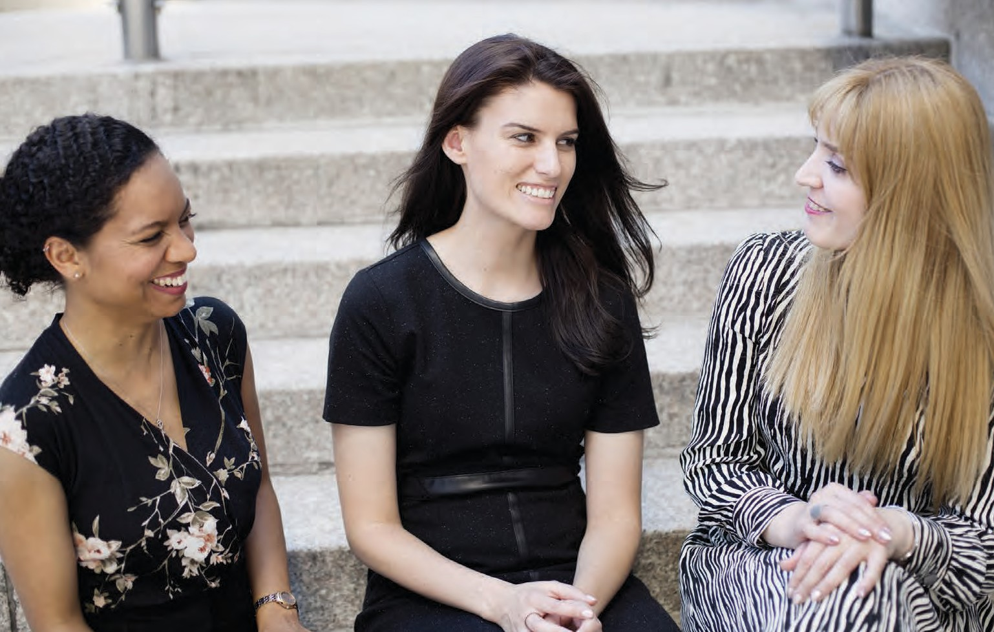










DI A MOND
SPONSOR

Slide 6


T H A N K Y O U T O O U R
P L A T I N U M
S P O N S O R

Slide 7

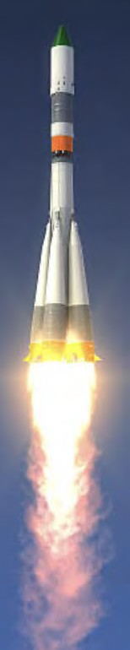














Philanthropy is not
Rocket Science
I
It’s about ﬁnding meaningful purpose
and contributing in whatever ways possible.
Together, we can do anything. Together, we will ﬁnd a cure.
Catherine & Adam Turner
Andrew, William, Carlye & Matthew
PLATINUM
SPONSOR

Slide 8

DOREL INDUSTRIES INC.
1255 Greene Avenue, Suite 300, Montreal, Quebec, Canada H3Z 2A4
Tel. : (514) 934-3034, Fax : (514) 934-9932
www.dorel.com
PLATINUM
SPONSOR

Slide 9



SC O TIAB ANK C OMMER CIAL B ANKING
Your trusted financial partner for all your business banking needs.
We understand the uniqueness of your business and industry. Our dedicated Business Banking Specialists and specialized teams work with you to provide advice and tailored solutions to help take your business to the next level.
Maria Mangiovacallo
Vice President, Commercial Banking, Quebec Region 514.758.2431
maria.mangiocavallo@scotiabank.com
Visit scotiabank.com/commercialbanking
® Registered trademark of The Bank of Nova Scotia.
PLATINUM
SPONSOR

Slide 10
C O N G R A T U L A T I O N S T O O U R W O M A N O F A C T I O N ,
C A T H E R I N E M E L L I N G T U R N E R !
Y O U M A K E T H E W O R L D A B E T T E R P L A C E
D I A N A F E R R A R A S C A L I A
PLATINUM
SPONSOR

Slide 11

PLATINUM
SPONSOR

Slide 12
T H A N K Y O U T O O U R
G O L D
S P O N S O R

Slide 13

GOLD
SPONSOR

Slide 14
C O N G R A T U L A T I O N S T O
C A T H E R I N E M E L L I N G T U R N E R O N T H I S
W E L L - D E S E R V E D H O N O U R !
P R O U D T O S U P P O R T T H E I C R F & T H E I R I M P O R T A N T W O R K .
M A R L E N E L E V E N S O N
GOLD
SPONSOR

Slide 15

GOLD
SPONSOR

Slide 16

The Azrieli Foundation proudly celebrates this year’s Women of Action honourees.
Your contributions inspire us all.
La Fondation Azrieli est fière
de célébrer les femmes d’action de cette année.
Vos contributions nous inspirent tous.
azrielifoundation.org
GOLD
SPONSOR

Slide 17
T H A N K Y O U T O O U R
S I L V E R
S P O N S O R

Slide 18
SILVER
SPONSOR

Slide 19

SILVER
SPONSOR

Slide 20

SILVER
SPONSOR

Slide 21
dwpv.com
Nous sommes fiers d’être commanditaire du
déjeuner du Women of Action
qui appuie le Fonds israélien de recherche sur le cancer
We are proud to sponsor the
Women of Action Luncheon
in support of the Israel Cancer Research Fund
DAVIES WARD PHILLIPS & VINEBERG S.E.N.C.R.L., s.r.l.
SILVER
SPONSOR

Slide 22











C O N G R A T U L A T I O N S T O I C R F F O R T H E O U T S T A N D I N G W O R K Y O U A R E D O I N G T O S U P P O R T
A D V A N C E M E N T S I N C A N C E R R E S E A R C H .
L I L L I A N & M O R R I S G O O D M A N
M I A & D A V I D G O O D M A N
SILVER
SPONSOR

Slide 23

T H A N K Y O U T O O U R
B R O N Z E
S P O N S O R

Slide 24
I D E D I C A T E T H I S M E S S A G E T O M Y D E A R P A R E N T S
D E B I & J A C K T I E T O L M A N
&
M Y B E L O V E D S I S T E R M A R I L Y N
“ F O R E V E R I N M Y H E A R T ”
A N G E L A
BRONZE
SPONSOR

Slide 25





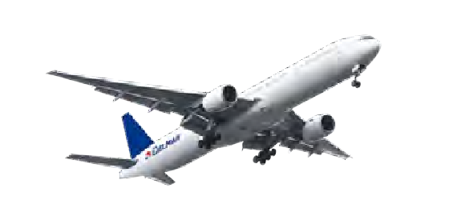


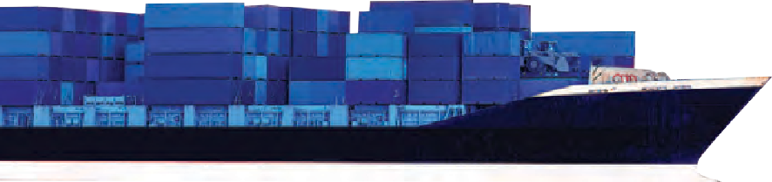






BRONZE
SPONSOR

Slide 26


Proud Supporter of ICRF!
Congratulations to the
2022 Women of Action Honourees
Anzie Stein
Catherine Melling Turner Dr. Sara Soldera
Robert Bard, President
BUILDING WEALTH FOR OUR CLIENTS FOR OVER 90 YEARS
Personalized Portfolio Management
1100 Rene Levesque Blvd. West,
Suite 650
Montrea
l, Quebec
.861.5841
H3B 4N4
T 514
T 877.551.5841
BRONZE
SPONSOR
dorchesterwealth.com

Slide 27

BRONZE
SPONSOR

Slide 28

BRONZE
SPONSOR

Slide 29
C O N G R A T U L A T I O N S T O A N Z I E S T E I N
C A T H E R I N E M E L L I N G T U R N E R
D R . S A R A S O L D E R A
O N T H I S W E L L - D E S E R V E D H O N O U R !
M A R L E N E & J O E L K I N G
BRONZE
SPONSOR

Slide 30
W I S H I N G I C R F & T H E
2 0 2 2 W O M E N O F A C T I O N H O N O U R E E S G O O D L U C K & C O N T I N U E D
G O O D F O R T U N E .
A L L T H E B E S T ,
L E E S A S T E I N B E R G
BRONZE
SPONSOR

Slide 31



BRONZE
SPONSOR

Slide 32

BRONZE
SPONSOR

Slide 33
C O M P L I M E N T S O F
T H E O R I N G E R F A M I L Y
BRONZE
SPONSOR

Slide 34
I N M E M O R Y O F
S E R E N & B E R I K R A T Z Z ” L H O L O C A U S T S U R V I V O R S
&
T H E I R D A U G H T E R R U T H K R A T Z Z ” L
BRONZE
SPONSOR

Slide 35
C O N G R A T U L A T I O N S T O M Y S I S T E R , J O R D A N N A F E I F E R ,
O N H E R T R E M E N D O U S C O M M I T M E N T & D E D I C A T I O N T O T H E
I S R A E L C A N C E R R E S E A R C H F U N D .
A L E X A N D R A F E I F E R & L E S W E X E L M A N
BRONZE
SPONSOR

Slide 36
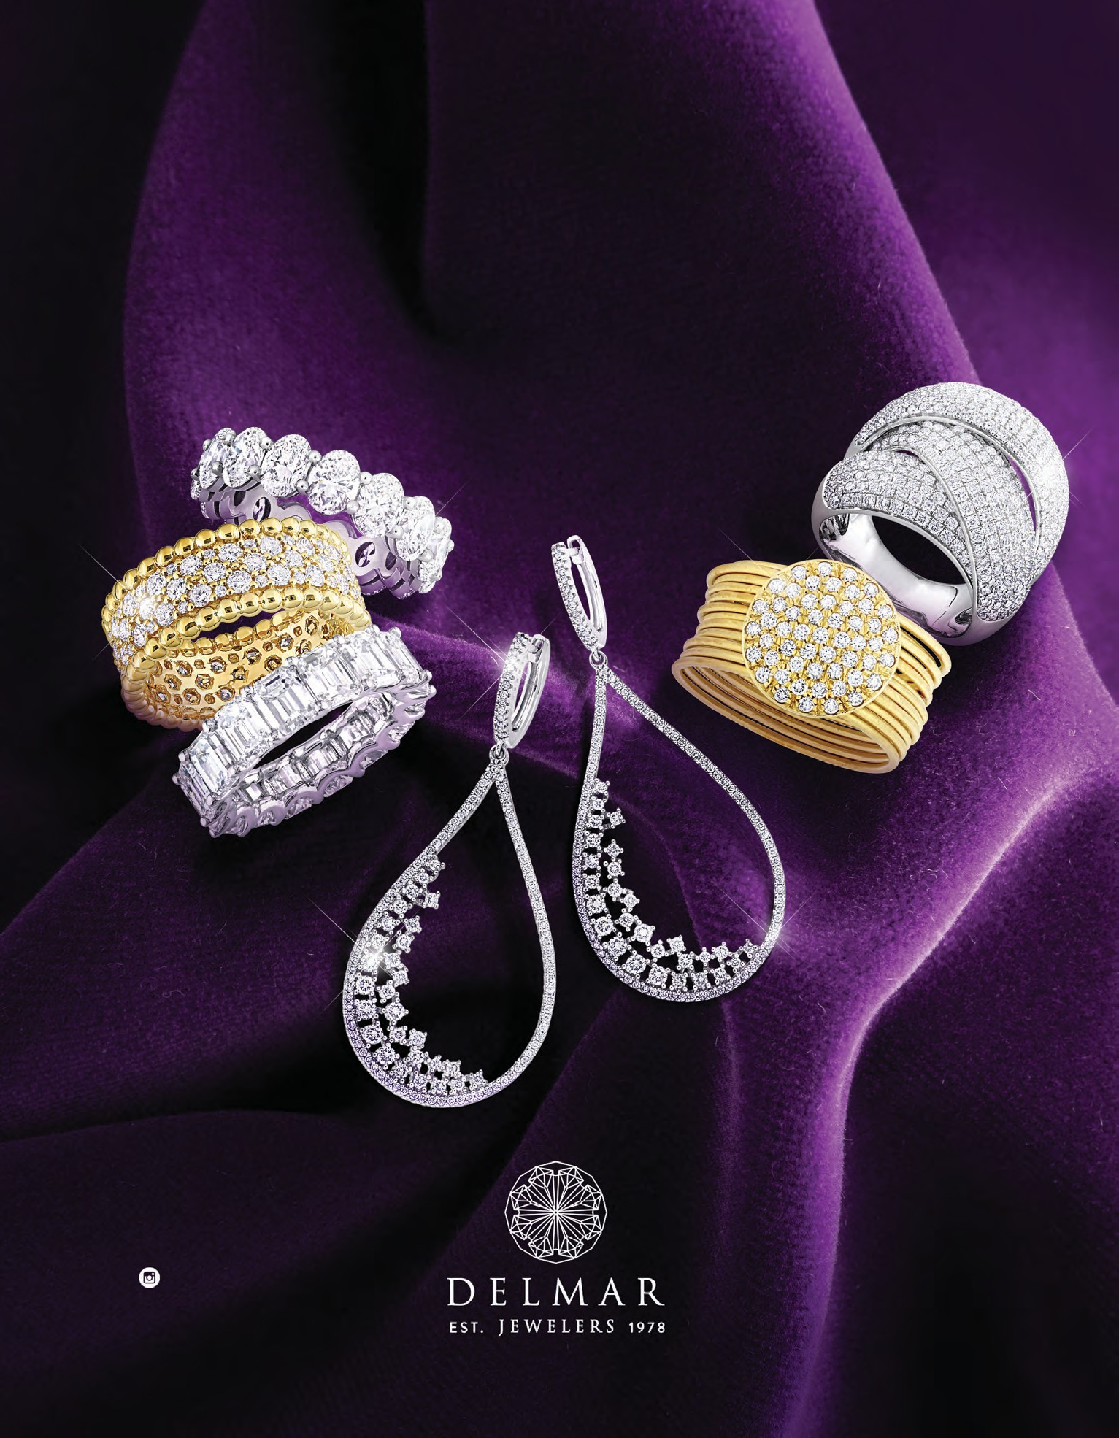
¤Èâ
and
¤sª
DELMARJEWELERS 4058 JEAN TALON WEST
(514) 875 -4800
MONDAY - THURSDAY: 9:30 AM - 5:00 PM
FRIDAY: 9:30 AM - 1 PM
SUNDAY: 11 AM - 4 PM
BRONZE
SPONSOR

Slide 37
P R O U D T O S U P P O R T T H E
I S R A E L C A N C E R R E S E A R C H F U N D
T H E D U B R O V S K Y F A M I L Y
BRONZE
SPONSOR

Slide 38
C O M P L I M E N T S O F
S A N D Y & J O E Y S C H R E T E R
BRONZE
SPONSOR

Slide 39
C O M P L I M E N T S O F
L E G R O U P E
D E S P A R O D O N T I S T E S
L O R N E A . W I S E M A N
B S C D D S D I P P E R I O F A C D F I C D
PERIODONTIST AND DENTAL IMPLANTS
2222 boul. René-Lévesque Ouest, bureau 200 Montréal, (Quebec) H3H 1R6
(514) 937-3535
BRONZE
SPONSOR

Slide 40





BRONZE
SPONSOR

Slide 41
W E A R E P R O U D T O H O N O U R T H E W O M E N O F A C T I O N
A N D T H E I M P O R T A N T W O R K O F
T H E I S R A E L C A N C E R R E S E A R C H F U N D
S U S A N & B A R R Y P A S C A L
BRONZE
SPONSOR

Slide 42
T O A L E X S H I L L E R A N D T H E E N T I R E
W O M E N O F A C T I O N C O M M I T T E E ,
W I T H A D M I R A T I O N F O R Y O U R D E V O T I O N & H A R D W O R K T O W A R D S T H E
I S R A E L C A N C E R R E S E A R C H F U N D
T H E L A V Y F A M I L Y
BRONZE
SPONSOR

Slide 43


C A T H E R I N E ,
WATCHING YOU HELP THE COMMUNITY FOR OVER 20 YEARS !
W E ’ R E S O P R O U D O F Y O U !
S Y L V I A & T E D D Y Q U I N T
J O D Y , S O P H I E , E M M A & M A T T
BRONZE
SPONSOR

Slide 44
T H A N K Y O U T O O U R
F U L L P A G E
A D S

Slide 45

FULL PAGE
ADS

Slide 46
C O N G R A T U L A T I O N S T O O U R F R I E N D C A T H E R I N E M E L L I N G T U R N E R
O N T H I S W E L L - D E S E R V E D R E C O G N I T I O N !
W E L O V E Y O U , D A V E & I S A
FULL PAGE
ADS

Slide 47

FULL PAGE
ADS

Slide 48
C O N G R A T U L A T I O N S T O S T E P H Z U C K E R , O U R W O M A N O F A C T I O N ,
O N A N O U T S T A N D I N G E V E N T !
W E A R E S O V E R Y P R O U D T O S U P P O R T I C R F A N D T H E I R I M P O R T A N T W O R K .
T H E S I L V E R F A M I L Y
FULL PAGE
ADS

Slide 49
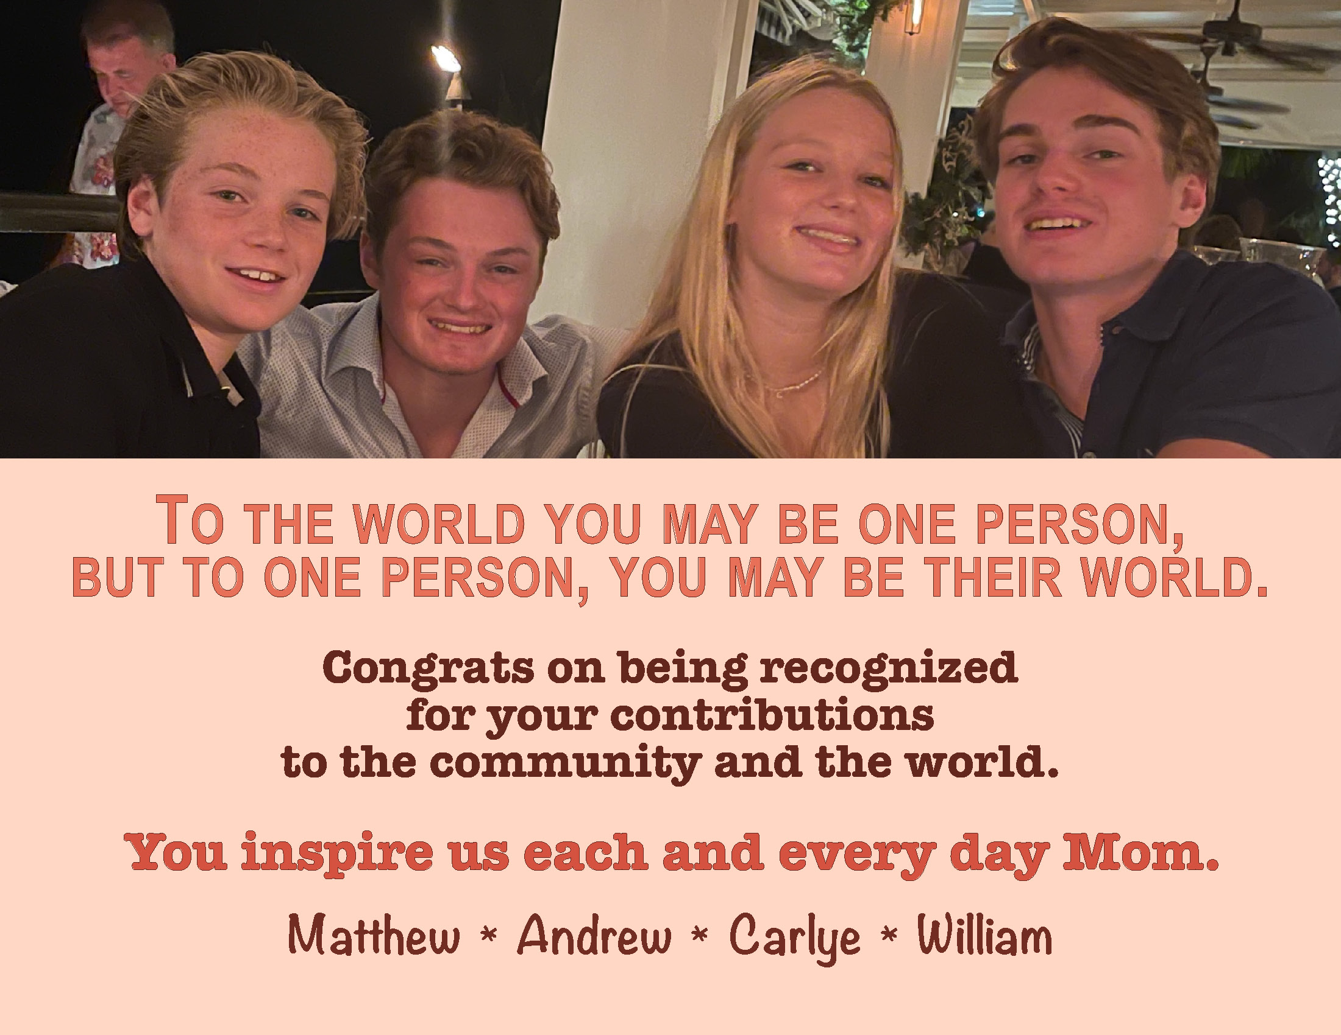
FULL PAGE
ADS

Slide 50
FULL PAGE
ADS

Slide 51
T O O U R W O N D E R F U L J E N N A ,
C O N G R A T U L A T I O N S O N C O - C H A I R I N G T H I S M O S T I M P O R T A N T E V E N T !
W E A R E S O P R O U D O F A L L O F Y O U R
A C C O M P L I S H M E N T S & H O W Y O U A L W A Y S S T R I V E T O H E L P O T H E R S .
L O V E ,
M O M , D A D , A L E X , H U D S O N
R Y A N ,
& K O B Y
FULL PAGE
ADS

Slide 52


LITIGATION / LITIGE
David Banon Carolyn Booth Robert Caron
Laurent Debrun Barry Landy
Jason S. Novak Neil G. Oberman
Charlotte Oger-Chambonnet Colombe Perreault
Henry Steinberg
TAX / FISCAL
Martin Bédard Justine Benoit Evan Bernstein
Philippe Brunelle Julien Cohen
Louis-Frédérick Côté
Charles Côté-De Lagrave Frédéric Delisle
Siham Doro, Notary Alexandre Dufresne Jonathan Éthier
Vincent Gendron François Giroux Joel Goldman
Morris Jacobson
Delilah Kanou, Notary Robert Korne
Pierre-Paul Persico
Theodore James Prahalis David H. Sohmer
Frank Zylberberg
CORPORATE / COMMERCIAL
Alexandre Brocherieux Adriana Cefis
Dan Donath
Daniel Frajman Alwynn Gillett Jordan Jaslow Rami Kaplo
Dennis Kounadis
Michael Kounadis
Catherine Pantoulis Nathalie Proulx
Frank M. Schlesinger Marvin Shahin
Morris Szwimer Ron Toledano
WE DO THE HEAVY LIFTING ALLIÉS DE VOTRE RÉUSSITE
1255 Peel Street, Suite 1000 Montréal, QC, H 3 B 2 T 9 Tel.: ( 514 ) 875 - 2100
FULL PAGE
ADS

Slide 53

FULL PAGE
ADS

Slide 54

FULL PAGE
ADS

Slide 55
T H A N K Y O U T O O U R
H A L F P A G E
A D S

Slide 56






C O N G R A T U L A T I O N S T O T H E
W O M E N O F A C T I O N 2 0 2 2 !
P A T R I C K & S U S A N B E N A R O C H E & F A M I L Y
HALF PAGE
ADS

Slide 57




YOU ARE UNIQUE.
AUTO I HOME I BUSINES
Boîtes de carton ondulé & Emballages écoresponsables Corrugated boxes & Eco-friendly packaging
À temps,
tel que commandé
On time, as ordered
1 800-361-5727
Mitchellincoln.ca
Nobody has the same home or the same car as you. Nobody has the same habits as you.
Because you are unique.
The same goes for your insurance. Others may try to sell you the best online price with endless forms for you to complete, but what you want is the right price for your situation, without wasting your time.
A broker who listens,
the right solution at the right price.
Westmount – LaSalle
514 363.3636
accentassurance.com
HALF PAGE
ADS

Slide 58

B R A V O T O A L L
T H E W O M E N O F A C T I O N P A S T A N D P R E S E N T ,
W H O W O R K T I R E L E S S L Y
T O W A R D S A W O R L D W H E R E C A N C E R I S N O L O N G E R
A T H R E A T .
S H E I L A K U S S N E R , O . C . , O . Q . , C . O . M .
HALF PAGE
ADS

Slide 59






Proud to Support
ICRF
westcoastconnection.com
HALF PAGE
ADS

Slide 60

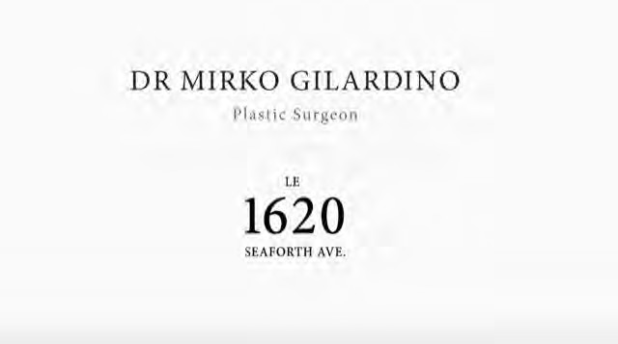
HALF PAGE
ADS

Slide 61
T H A N K Y O U T O O U R
Q U A R T E R P A G E
A D S

Slide 62
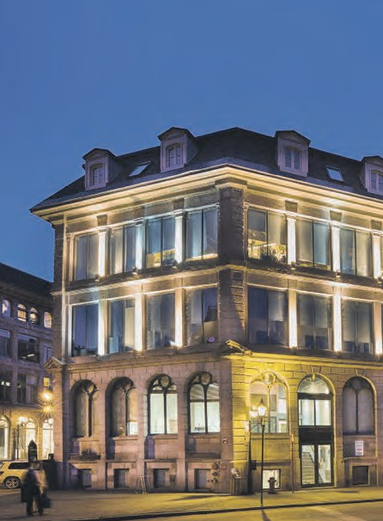


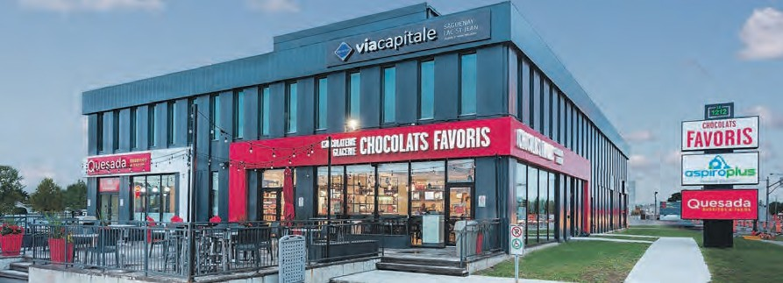
C O N G R A T U L A T I O N S T O T H E
W O M E N O F A C T I O N H O N O U R E E S F O R T H E I R A C H I E V E M E N T S
& H A R D W O R K !
VISION DYNAMISM PERFORMANCE
514.281.4040
sandalwoodmgt.com
QUARTER PAGE
ADS

Slide 63
K R A V I T Z , K R A V I T Z
A V O C A T S / A D V O C A T E S 5 1 4 - 7 4 8 - 2 8 8 9
QUARTER PAGE
ADS

Slide 64
T H A N K Y O U T O O U R
B U S I N E S S C A R D
A D S

Slide 65
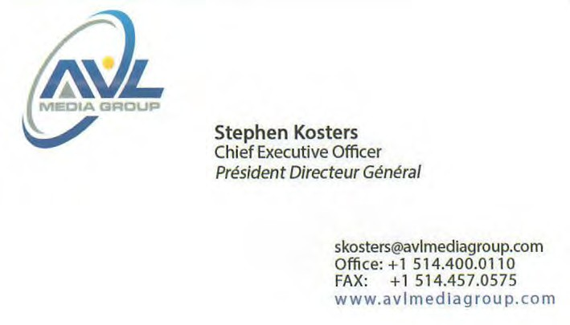

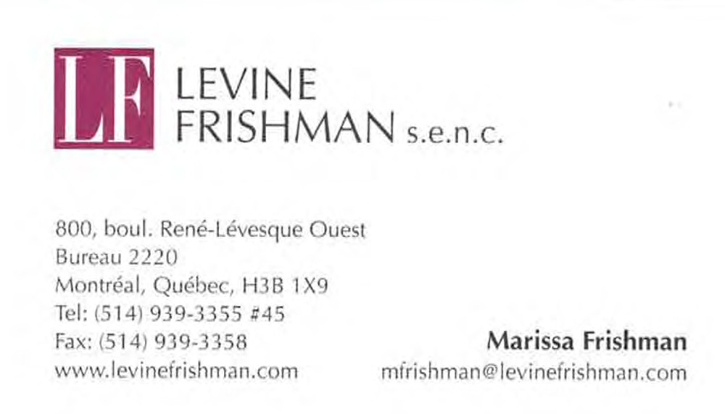
3449, avenue du Musée, Montréal, (Québec) H3G 2C8
T 514 849-1188
F 514 849-1176
With our compliments Avec nos compliments
SNRLEGAL.COM
BUSINESS CARD
ADS

Slide 66

C O M P L I M E N T S O F
LOWEN AND PETER ROSENTHAL 4612 STE-CATHERINE ST. WEST WESTMOUNT, QC H3Z 1S3
OFFICE: (514) 932-2577
FAX: (514) 932-1456
WWW.ROSENTHALLIFEGROUP.CA
BUSINESS CARD
ADS

Slide 67


Thank you
W O M E N O F A C T I O N C O M M I T T E E
HONORARY CHAIRWOMEN
COMMITTEE
PRESIDENT
JORDANNA FEIFER
ANNE-MARIE BOUCHER DEBRA MARGLES
DALE BOIDMAN JILLIAN CLIMAN LAUREN FORMAN
SOPHIE LAFLECHE OLIVIA LEVY
LAURA SCHEIM ELLEN SCHRETER
BRITTANY SHILLER STEPHANIE ZUCKER
SCIENTIFIC ADVISORY BOARD
DR. WALTER GOTLIEB
CO-CHAIRS
ALANA WEXLER SCHWARTZ JENNA SCHWARTZ
ALEXANDRA SHILLER
CHIEF EXECUTIVE OFFICER
STU GUTTMAN
GENERAL MANAGER
SHERYL RAMROOP

Slide 68


L A U N C H I N T O A C T I O N
T O G E T H E R W E C A N F I N D A C U R E

